Slide 1
HC Drug-Free Video Youtube: https://youtu.be/SxdSHAUln8s Vimeo: https://vimeo.com/231604408

Slide 2
Back to School Night September 6, 2017
Centennial High School
Performance, Rigor, and Engagement

Slide 3
Boosters/PTSA

Slide 4
Centennial High School
Student
Experience
What does it take to make a difference?

Slide 5
Centennial High School
Academic enrichment
A voice for parents, students, & teachers
Communication
Faculty & staff appreciation
Services & support

Slide 6
Committees
Staff appreciation
Cultural advocacy
SAT/ACT prep
Eagle’s Eye Online newsletter
Student Directories
CHS Late Night After Prom Party
and many other efforts…
www.chs-ptsa.org

Slide 7
Fundraising
Provide classroom supplies and equipment not provided by the administration
Clothing to Cash Bin
AmazonSmile
Pancake Breakfast
Restaurant Nights
and other efforts…
www.chs-ptsa.org

Slide 8
Centennial High School
CHS Boosters support for ALL extra-curricular activities including sports teams, clubs and honor societies
Notes:
The Howard County Public School System does NOT have the budget to provide everything support all of the money needed for our sports teams (e.g., uniforms, etc.) nor for extracurricular clubs and organizations

Slide 9
100% of the funds raised are used to support Centennial High School students
Fundraising
Memberships
Turkey Trot 5K
Booster Gala
Spirit wear
Concessions
Banners/Bricks
Sponsorships
and more…
www.centennialboostersonline.com
Notes:
All volunteer force. In 2015 alone, the Boosters provided more than $50,000 to 46 different clubs and teams.

Slide 10
Centennial High School
Student
Experience
It takes all of us to make a difference!

Slide 11
Administration
Claire Hafets, Principal
Cameron Rahnama, Assistant Principal, A-I
Tracy Scaltz, Assistant Principal, J-O
Sandra Suber, Assistant Principal, P-Z

Slide 12
State of the School

Slide 13
Performance on MD state assessments in 2017
97% passed the Government HSA in May 2017.
PARCC data (859 test-takers April/May 2017) *725 cut-off score for Maryland.
ELA 10: (N=375) : 93% met MD score (89% in 2016)
5: Exceeded Expectations (MD score range: 794-850): 93 students
4: Met Expectations (MD score range: 750-793): 196 students
3: Approached Expectations (MD score range: *725-749): 61 students
2: Partially-Met Expectations (MD score range: 700-724): 18 students
1: Did not Meet Expectations (MD score range: 650- 699): 7 students

Slide 14
Algebra I: (N=110): 77% met MD score (58% in 2016)
5: Exceeded Expectations (MD score range: 805-850): 1 student
4: Met Expectations (MD score range: 750-804): 57 students
3: Approached Expectations (MD score range: *725-749): 27 students
2: Partially-Met Expectations (MD score range: 700-724): 22 students
1: Did not Meet Expectations (MD score range: 650- 699): 3 students

Slide 15
Algebra 2: (N=363): 84% met MD score (84% in 2016)
5: Exceeded Expectations (MD score range: 808-850): 63 students
4: Met Expectations (MD score range: 750-807): 179 students
3: Approached Expectations (MD score range: *725-749): 64 students
2: Partially-Met Expectations (MD score range: 700-724): 36 students
1: Did not Meet Expectations (MD score range: 650- 699): 21 students

Slide 16
PSAT Data October 2016

Slide 17
AP Participation and Performance in 2017
82% of CHS students participated in 1 or more AP courses by the end of 12th grade
Of the 683 CHS AP students who tested in May 2017, 568 students (83%) earned one or more score of 3 or higher. (Student participation increased from 560 students in 2015 to 582 students in 2016 to 683 students in 2017).
1,415 of the total 1,713 AP exams taken (83%) resulted in a score of 3 or higher. (Number of exams taken increased from 1,445 exams in 2015 to 1,545 exams in 2016 to 1,713 exams in 2017).

Slide 18
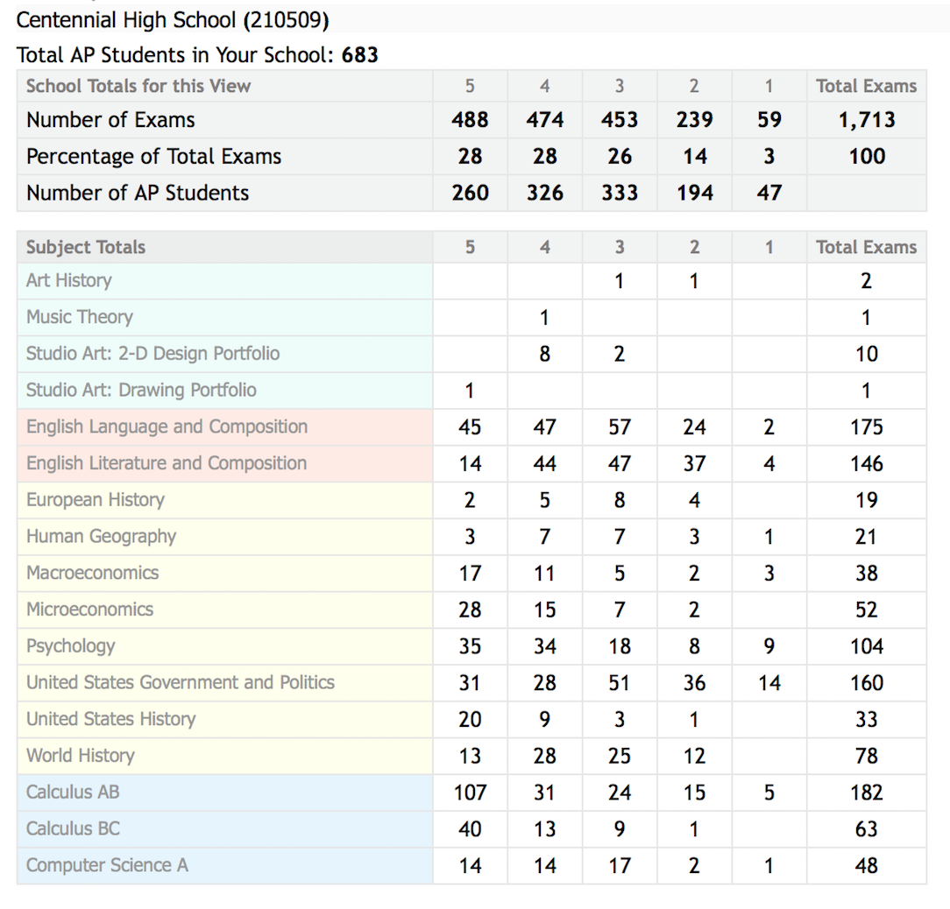

Slide 19
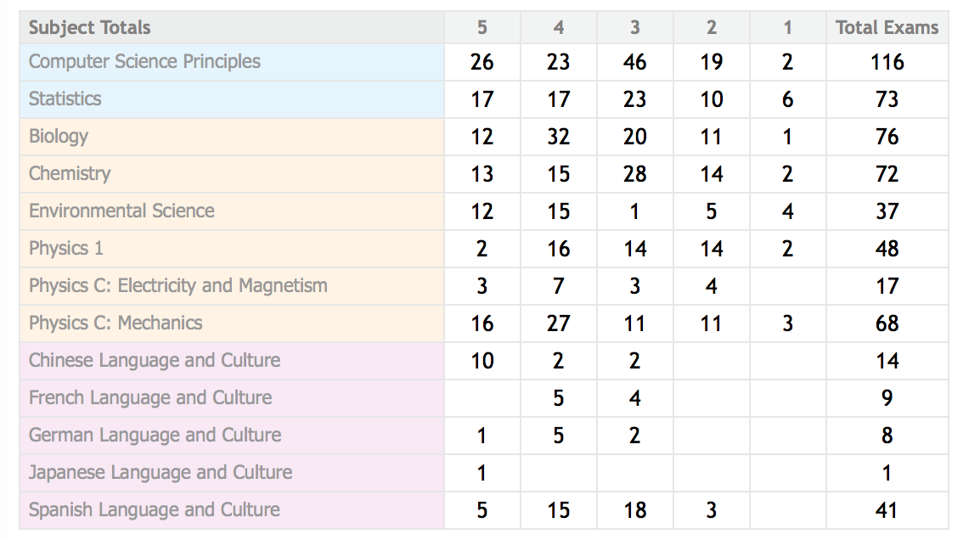

Slide 20
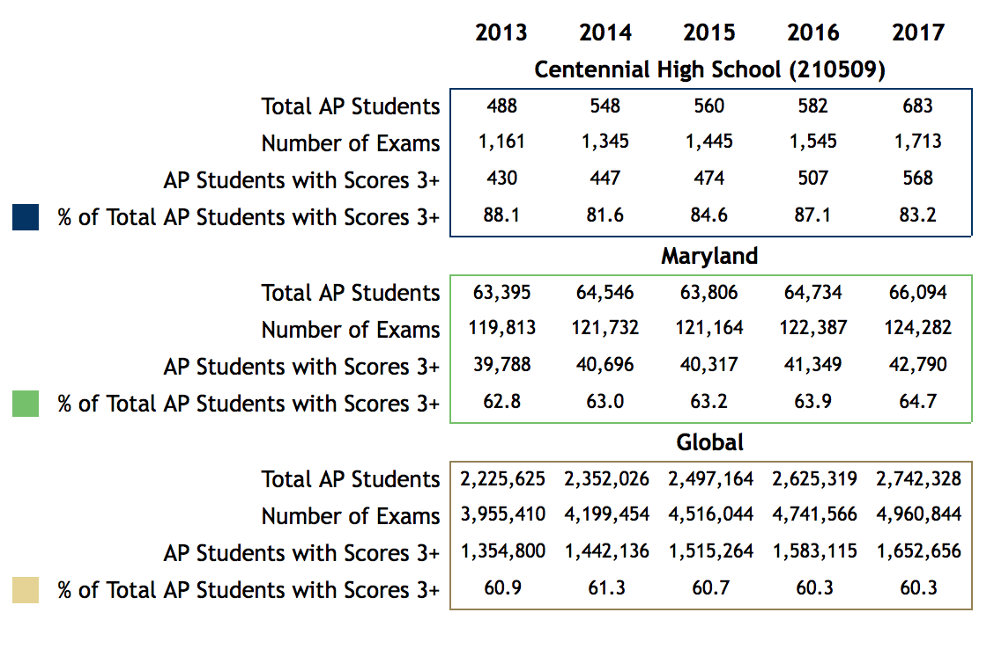

Slide 21
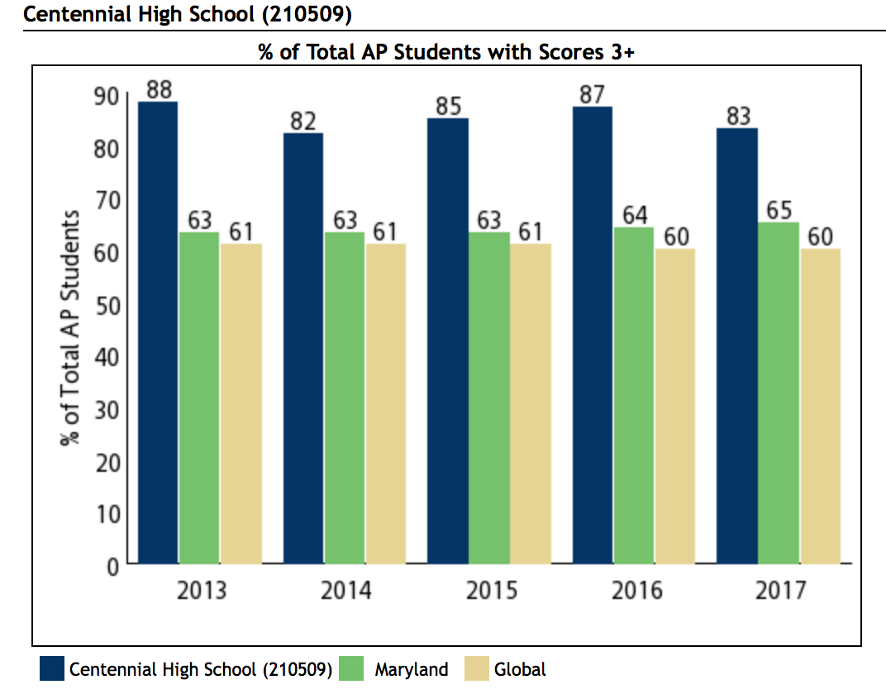

Slide 22
2017 AP Scholars
The AP Scholars program awards distinct levels of recognition based on academic excellence and performance criteria. A total of 317 CHS students earning an average score of 4.14 (CHS had 277:4.19 in 2016, 264:4.21 in 2015) received accolades in the following categories:
AP Scholars: Granted to students who receive scores of 3 or higher on 3 or more AP exams CHS had 101 AP Scholars earning an average score of 3.27 (CHS had 73:3.23 in 2016, 79:3.25 in 2015)
AP Scholars with Honor: Granted to students who receive an average score of at least 3.25 on all AP Exams taken, and scores of 3 or higher on four or more of these exams CHS had 42 AP Scholars with Honor earning an average score of 3.81 (CHS had 51:3.72 in 2016, 39:3.83 in 2015)

Slide 23
2017 AP Scholars
AP Scholars with Distinction: Granted to students who receive an average score of at least 3.5 on all AP Exams taken, and scores of 3 or higher on five or more of these exams CHS had 174 AP Scholars with Distinction earning an average score of 4.30 (CHS had 153:4.36 in 2016, 146:4.37 in 2015)
National AP Scholars: Granted to students in the United States who receive an average score of at least 4 on all AP Exams taken, and scores of 4 or higher on eight or more of these exams CHS had 52 National AP Scholars earning an average score of 4.56 (CHS had 57:4.61 in 2016, 48:4.67 in 2015)
AP International Diploma: Granted to students who earn scores of 3 or higher on five or more total AP exams based on the following exam criteria: Two AP exams from two different World language and culture courses or Two AP exams from one world language and culture course and one English course CHS had 2 AP International Diplomas earning an average score of 4.04 (CHS did not have any in 2016, 1:4.30 in 2015)

Slide 24
Centennial Scholars Program
This past year, 99 CHS students received the Centennial Scholars distinction for having maintained a “B” average and having participated in at least 6 AP exams in 4 distinct subject areas and scoring at least a 3 or higher on all exams (CHS had 88 in 2016)
Way to go Eagles!

Slide 25
Equity and Excellence
Demonstrates the proportion of CHS’s entire senior class who scored a 3 or higher on an AP Exam at any point during high school.
Class of 2014, 53% of CHS seniors met this criteria.
Class of 2015, 58.6% of CHS seniors met this criteria.
Class of 2016, 59.8% of CHS seniors met this criteria.
Class of 2017, 63.4% of CHS seniors met this criteria.
Way to go Eagles!

Slide 26
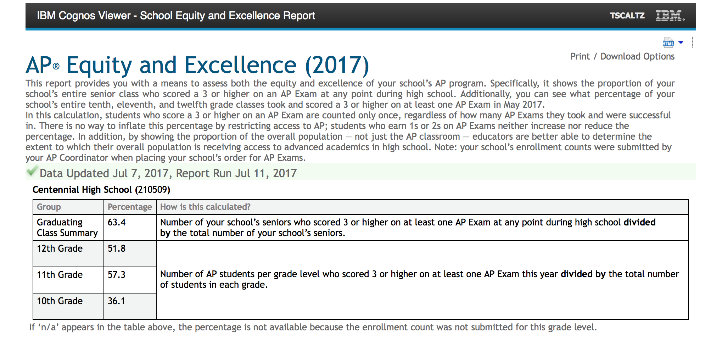

Slide 27
Staying informed

Slide 28
School News and Information
Email
Print
Social Media
Video
In Person
Notes:
School Communications – OVERVIEW
Engaging parents and families as partners in education is one of the highest priorities of our school system and school. We use several communications tools to keep parents informed of what’s happening in the school and provide the information you need to make informed decisions regarding your child’s education. I’ll describe each of these in a moment [covered on following slides].
Often – personal communications are best.
Most important is that you feel comfortable reaching out to teachers and administrators whenever you have a concern or question. We’re happy to meet with parents or have you visit the classroom. Please call the school office with questions or to set up a convenient time. We also value parent involvement in school activities.
Feel free to contact any teacher or administrator via Email, or make an appointment to meet to discuss your concerns.

Slide 29
HCPSS System and School News
Email
Text
School News
HCPSS News
Emergency Notices
Optional for
Emergency Notices
Only
Details: www.hcpss.org/hcpss-news/
Notes:
Parents receive news and announcements from our school and from the school system via the HCPSS News service.
Parents are automatically registered for this service. Email messages are delivered to the contact information that you provide in the Family File.
You will receive via email:
School newsletters & other communications
System-level announcements
Emergency notifications (school closings/delays).
Text messages: Parents are given the option to receive text messages. Text messages are sent only for urgent/emergency announcements (school closings and delays, etc.)
New parents are sent a text message to opt-in for text alerts. – if you didn’t receive this, visit www.hcpss.org/hcpss-news/ to troubleshoot.
Text alerts are sent to the mobile phone number identified in the Family File.
If you were already opted-in to receive text messages last year, and your phone number has not changed, you do not need to opt-in again.
Community members and others can sign up to receive email and/or text messages at www.hcpss.com/hcpss-news (or visit the home page www.hcpss.org and click on the link at the bottom of the page).

Slide 30
School Closings/Delays
www.HCPSS.org
HCPSS News
@hcpss
HCPSS TV
HoCoSchools
Verizon 42
Comcast 72
Notes:
School Delays and Closings (usually weather-related) are communicated through several channels:
HCPSS homepage: www.hcpss.org -this is the first and most complete source of information
HCPSS News emails and texts
Social media: Twitter & Facebook
HCPSS TV – channel 42 (Verizon) and 72 (Comcast)

Slide 31
CHS website/CHS Twitter @hcpss_chs
Announcements and news
School calendar
Staff directory
Academics
Student activities, sports, clubs
Links to HCPSS Connect and other resources
And more
http://chs.hcpss.org
Notes:
[Fill in on slide: school name & web address initials]
Our school website is a one-stop destination where you can quickly find:
School calendar
Announcements and news
Academic departments
Student activities, sports, clubs
Staff directory and email links
Quick Links to HCPSS Connect, system website, and other resources
It provides mobile access and user-friendly navigation.

Slide 32
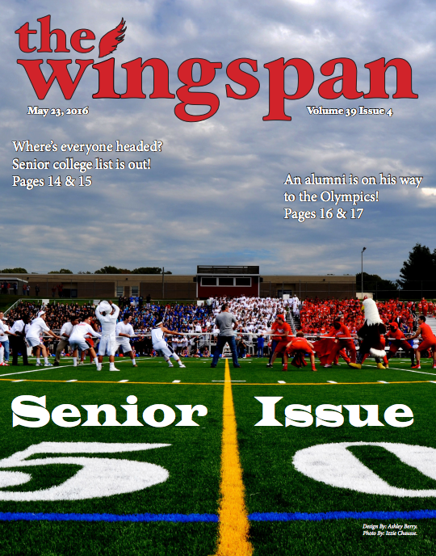
The Wingspan
100% Student Run
9th –12th Grade Team
New & Improved Print edition
Online Access
More Articles Published
Updates on Sporting Events
ALL PRINT ISSUES PUBLISHED ONLINE in PDF
Go to Website
On the right side under “Quick Links” click “Print Edition Archives”
Link also included in the CHS email notices
Follow us on twitter: @CHSWingspan
Email us at: chswingspan@gmail.com
https://www.chswingspan.com

Slide 33
Social Media
[CHS] Twitter: @hcpss_chs
HCPSS Facebook: www.Facebook.com/HoCoSchools
HCPSS Twitter: www.Twitter.com/HCPSS
Interact with the Superintendent:
Twitter: https://twitter.com/mjmsuper
Blog: superintendent.hcpss.org
Notes:
[insert school Twitter handle on slide if using; remove 1st line if not]
Link to our social media sites:
Get up-to-the-minute updates, news, student and school happenings, and announcements
Interact with the school and system

Slide 34
Mobile App
Notes:
The HCPSS Mobile App is available free to download for iphones, iPad, and Android devices in the app stores (search for “HCPSS”).
The app makes it quick and easy to find the information you need, when you need it. It provides:
Simplified access to information
On-the-go access and quick links
Compiles messages and calendar dates from all of the schools that your children attend, as well as school district information

Slide 35
SYNERGY STUDENT
INFORMATION
SYSTEM
CANVAS
LEARNING
SYSTEM
FAMILY FILE
www.hcpss.org/connect
Notes:
HCPSS Connect is the one-stop portal to access Synergy, Canvas, and the Family File.
The Synergy Student Information is the source for official student records & grades.
It gives teachers, administrators, and parents with the digital tools to easily access student information.
The Canvas Learning System gives teachers, parents, and students tools to communicate, collaborate, and connect.
Both systems are extremely easy to learn and to use.
Find full details and instructions online at www.hcpss.org/connect
Benefits of HCPSS Connect for Parents, Students & Teachers:
Improved & consistent user experience
Common digital platform for all schools & grades
Improved communication and collaboration
Anytime/anywhere across multiple devices
Single sign-on - 1 user/pass for HCPSS Connect

Slide 36
Update Student Information
Parent contact information
Medical data and contacts
Afterschool transportation
Data privacy preferences
Athletic participation forms
www.hcpss.org/connect
Notes:
The Family File on HCPSS Connect provides important information about your student. All information is confidential.
It is important that parents update the Family File with current data about your student including:
Parent emails and phone numbers
student medical contact data
afterschool transportation options
data privacy options
Log into HCPSS Connect and click the My Account tab. Save your changes by clicking the Update Account button.
Family File now remains open throughout the school year, so you can make changes at any time they occur. Parents without online access can provide this information through a paper “Emergency Procedure and Confidential Student Information” form. Contact the school office for a copy of this form.
New this year - Athletic participation forms can be completed online in Synergy.

Slide 37
Getting Help
Login and Password assistance:
Contact School Office
Guides and Resources:
HCPSS Connect Homepage
Notes:
Parents will continue to use the same log in credentials as in prior years.
Parents of students new to HCPSS will receive their login information via US Mail.
For help with your login or password: call the School Office
For help in using Canvas, Synergy, or the Family File, see the many guides and resources on the HCPSS Connect homepage (www.hcpss.org/connect)

Slide 38
What to Expect: 2017-2018 School Year
Teacher Homepage
Student Privacy Information
Course information
Calendar due dates
Calendar test dates
CANVAS
Assignment details
Student skill building (grade appropriate)
mobile app
Notes:
CANVAS EXPECTATIONS and Growth plans for teachers the 2017-2018 school year:
This year all teachers will be posting information in Canvas that parents can access through HCPSS Connect or the Canvas Parent Mobile App for iOS or Android.
Teachers are expected to maintain:
Teacher Homepage
Student Privacy Information - Information on homepage regarding teachers’ use of recording devices and digital tools for school-related activities
Course information
Calendar due dates - Long term project due dates on the day they are assigned
Calendar test dates - Post test dates on the Canvas calendar 3 school days in advance
Assignment details - Include details such as directions, materials, links, resources, etc. as appropriate
In addition, teachers will be helping students develop their Canvas / online learning skills with grade appropriate activities.

Slide 39
College and career readiness program
24/7 access
7500 colleges
Career interests and strengths
Video interviews with industry leaders
4-year high school planning
Video overview: “Intro to Naviance” on YouTube
Notes:
Aqua box links to the video (2.2 minutes) – Click during presentation to show if desired
Naviance is a college and career readiness program that connects student achievement with post-secondary planning. Naviance can greatly help each and every student in this school system.
Naviance is accessible 24/7 by students, parents and teachers to:
Search through thousands of colleges by interest area and other parameters
Watch video interviews with industry leaders in career fields of interest.
Develop a 4-year high school academic plan.
Take Individualized assessments to better understand career interests, learning styles, and personal strengths.
See a short video overview – search on YouTube for “Intro to Naviance” [click on aqua box on slide to view]
link: https://www.youtube.com/watch?v=7wv5Oea3Fg8
(The Naviance handouts provide more information.)

Slide 40
FAFSA: Free Application for Federal Student Aid
New application window: Oct 1 – Mar 1
Apply fall of senior year for best consideration
All students should apply; required by many colleges and scholarship organizations
Apply online: fafsa.ed.gov
Notes:
Students can file a 2018–19 FAFSA as early as Oct. 1, 2017 (earlier than the Jan.1 start date in previous years). This earlier submission date is a permanent change, enabling students to complete and submit a FAFSA as early as October 1 every year.
Students are required to report income information from an earlier tax year. For example, on the 2018–19 FAFSA, students (and parents, as appropriate) will report their 2016 income information, rather than their 2017 income information.
Students should submit a FAFSA application in the fall of their senior year. Financial aid is distributed on a first come, first served basis, so early application is encouraged. ALL students should apply–even if they may not be eligible for need-based aid.
FAFSA is used by many colleges and scholarship organizations as part of application requirements.
The deadline for Federal and Maryland applications is March 1, 2018.

Slide 41
PARCC
Notes:
Partnership for Assessment of Readiness for College and Careers (PARCC) is the name for the standardized reading, writing and mathematics assessments implemented in all Maryland schools. PARCC assessments are directly aligned to the Common Core standards. PARCC replaced the Maryland School Assessment (MSA) for math and reading/English language arts and the High School Assessments in English 10 and Algebra I.
PARCC benefits:
Indicates how closely students, beginning in Grade 3, are on track to graduate college- and career-ready.
Gives teachers regular results to guide learning and instruction.
Provides data comparable across districts and states.
Scoring:
The PARCC assessments are on a 5 point scale:
1=Did not yet meet expectations
2=Partially met expectations
3=Approached expectations
4=Met Expectations
5=Exceeded expectations
In high school courses, a score of 4-5 indicates students are on track to graduate prepared for colleges and careers . In future years, 4-5 will be used by in-state community colleges for placement in credit bearing courses.
Students hand-carry results home in the first few weeks of the following school year

Slide 42
PSAT – Grades 9-11
Notes:
Grade 9, 10 and 11 students will take the PSAT on October 11, 2017.
The PSAT is a good indicator of how a student will perform on SAT and ACT college entrance exams. it is important that every student take this test seriously and do their very best.
Taking the PSAT benefits every student – whether college-bound or planning to enter a career upon graduation. The PSAT student report identifies areas for improvement and links, via the student’s College Board account, to personalized study resources in the online Khan academy.
PSAT results also include an AP Potential Index, which is useful in identifying students who may be ready for Advanced Placement (AP) courses.
Home reports are sent home with students in Dec/January. If students record an email address on their test booklet, they will receive an email with results prior to the release of paper home reports.

Slide 43
SAT – Grades 11-12
Excellent preparation
for higher education
Admission requirement at many colleges
Notes:
The SAT is a standardized test, published by the College Board, designed to measure high-school level knowledge in three sections: evidence based reading and writing, mathematics and an optional essay. Reading/writing and mathematics are scored on a scale from 200 - 800. The essay will receive three scores between 2 - 8.
Most students take the SAT during their junior or senior year of high school. Most colleges and universities consider the SAT, in addition to other student information, when making admission decisions.
College Board recently redesigned the SAT to more accurately predict student readiness for college-level work, to reflect the knowledge and skills that are essential for college success, and to align with the rigorous instruction taught in the best high school courses.
Changes in the new SAT include:
Students must support answers based on evidence found in a variety of sources.
The essay requires analysis of a variety of sources, a skill that is expected in many college writing assignments.
The math section is better aligned with current research and college preparatory standards.
Students apply reading, writing, language and math skills to answer questions in science, history and social studies contexts across all components of the exam.
Every test includes an excerpt from one of the founding documents (e.g., Declaration of Independence, Bill of Rights, Federalist Papers) with questions pertaining to concepts such as freedom, justice and human dignity.
No scoring penalty for wrong answers.
[If applicable:] Students can sign up for optional SAT Preparation courses here at the school. We’ll provide information on those later in the year.
SAT tests are given on Saturdays in the spring.
Find schedules, and more information about the test, on the College Board website, www.collegeboard.com.

Slide 44
Advanced Placement (AP) – Grades 10-12
Excellent preparation
for college
Scores of 3-5 can
earn college credit
ALL students should consider AP
Notes:
The AP exam program is run by the College Board. Toward the end of each school year, students can take these very rigorous exams in a wide variety of subjects. AP exam scores range from 1 - 5, and many colleges accept scores of 3, 4, or 5 in lieu of taking a college course. This means that a student can enter their freshman year of college with college credit already under their belt.
Students may also take an AP course but choose not to take the AP exam, and research shows that just the course alone is beneficial. Students who experience the rigor of an AP course are better prepared to succeed in a college course.
The bottom line is that Advanced Placement is a great preparation for college. We encourage all Grade 10-12 students to consider taking AP classes.

Slide 45
NGSS Science Curriculum
NGSS Integrates:
Scientific and engineering practices
Crosscutting concepts across scientific disciplines
Core ideas in science
More information: nextgenscience.org
Notes:
The K-12 science curriculum is aligned to the Next Generation Science Standards (NGSS), which were jointly developed by professional scientists and educators. Maryland adopted the Next Generation Science standards as the Maryland Science Standards in 2013.
The NGSS combine and emphasize scientific and engineering practices, crosscutting concepts, and core ideas in science that all K-12 students should master in order to prepare for success in college and 21st century careers.
The HCPSS science curriculum integrates science and engineering practices with important disciplinary ideas from the three major scientific disciplines: earth/space science, life science (biology), and physical science (chemistry and physics)
The science curriculum is designed to prepare students with sufficient core knowledge so they can later acquire additional information on their own, because science knowledge is continually expanding.
Our goal is to develop science literacy and a solid foundation for success in higher education and careers in science or engineering.

Slide 46
HS Science Course Requirements
Core courses in each major discipline:
Earth/Space science
Life science (biology)
Physical science (chemistry and physics)
Notes:
High school students must complete three laboratory science courses. Students should select among the core courses so they have experience in each of the three major science disciplines: Earth/Space, Life (biology), and Physical science (chemistry & physics).
Students may choose among a variety of courses to fulfill this requirement, and are not required to take a certain course sequence. The recommended course sequence begins with Earth/Space Science in grade 9.

Slide 47
Maryland Integrated Science Assessment (MISA)
Notes:
MISA (Maryland Integrated Science Assessment) is the new standardized science assessment aligned to the NGSS. MISA will include concepts from each of the major science disciplines: Earth/Space science, Life science (biology), and Physical science (chemistry & physics). MISA supersedes the Biology HSA.
Our goal is to teach students to be scientifically literate, rather than teaching to pass a standardized test. Thus, there is not a specific course aligned to MISA; instead, it is to be taken after students have completed coursework in all three major science disciplines.
MISA will be implemented for the first time this school year (2017-18). However, revisions to the science curriculum went into effect last year, to ensure all students are exposed to the science concepts that will be included on the MISA.
All students must participate in MISA, with the exception of students who have already participated in the Biology HSA. However, MISA pass scores will not be a HS graduation requirement until 2020-21. This year’s 9th graders (graduating class of 2021) will be the 1st cohort to be accountable on the MISA.
HCPSS will continue to provide updates on MISA as they become available.

Slide 48
Interactive School Menus App
Food descriptions
Nutrition and allergens
Carb counts
Pre-payment links
Menus
Breakfast and lunch
hcpss.nutraslice.com
Notes:
HCPSS offers online school menus through a website and mobile app by Nutrislice.
The interactive menus provide access to up-to-the-minute content anytime, anywhere.
The innovative school menu site features nutrition and allergen information for all Howard County school meal items, both breakfast and lunch, and includes:
Carb counts
Allergen filters
Food descriptions and photos
Menu item rating system
Links to MySchoolBucks pre-payment options
Monthly menu email subscription sign-up
And more
Menus are available in several languages: English, Spanish, Korean, Chinese, and French.
Options for using the interactive menus:
Online: hcpss.nutrislice.com
Download the free app, “School Lunch by Nutrislice,” in the Google Play or App stores.
Select the “Menus” icon on the HCPSS mobile app

Slide 49
Responsible Use of Technology and Social Media
Notes:
Communications technology, including social media, is a fact of modern life. Learning to use technology effectively and responsibly is an important part of every student’s education.
HCPSS continues to encourage responsible use of technology and social media among students and all community members. You’ll see messages like this one posted in schools. Additional communications and events for students and families explore this important topic.
Preventing cyberbullying is an important part of this effort. This is a growing problem affecting many students. All middle and high school agenda books include a page about Grace’s Law with tips for students to protect themselves and others. [see Grace’s Law handout]

Slide 50
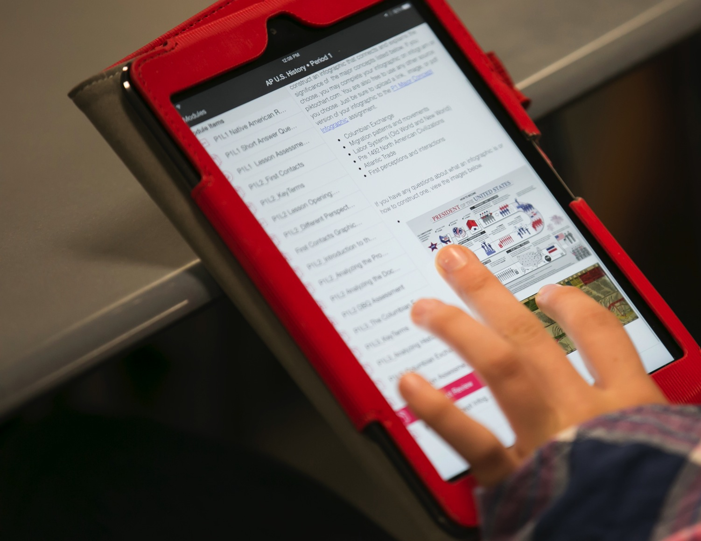
Notes:
The HCPSS is committed to providing students and staff a next-generation learning environment in which every student has access to learning experiences and instruction designed around communication, collaboration, creativity, and critical thinking.
Bring your own device (BYOD) is a program that allows students in middle and high school to use their personal devices (phones or tablets) for instructional activities. BYOD enables students to connect to the network to gain access to instructional resources, class projects, etc.
BYOD is OPTIONAL. Students are never required or expected to bring a personally-owned device to school. When an instructional activity is planned that needs access to individual technology, devices will be provided for use for students who do not have their own technology.
Use of Personal Devices in school for non-instructional activities:
High school students may carry their personal communication devices with them during the school day. Devices must be turned off or silent at all times.
Devices may not disrupt instructional activities and should be put away (in pocket, backpack, or locker). Students may use their devices before and after school, during lunch, and during hallway transition times.
[Note: To clarify a common misperception: There are NO PLANS to introduce BYOD in elementary school.]
More information is available online at www.hcpss.org/byod and in the Student Parent Handbook.

Slide 51
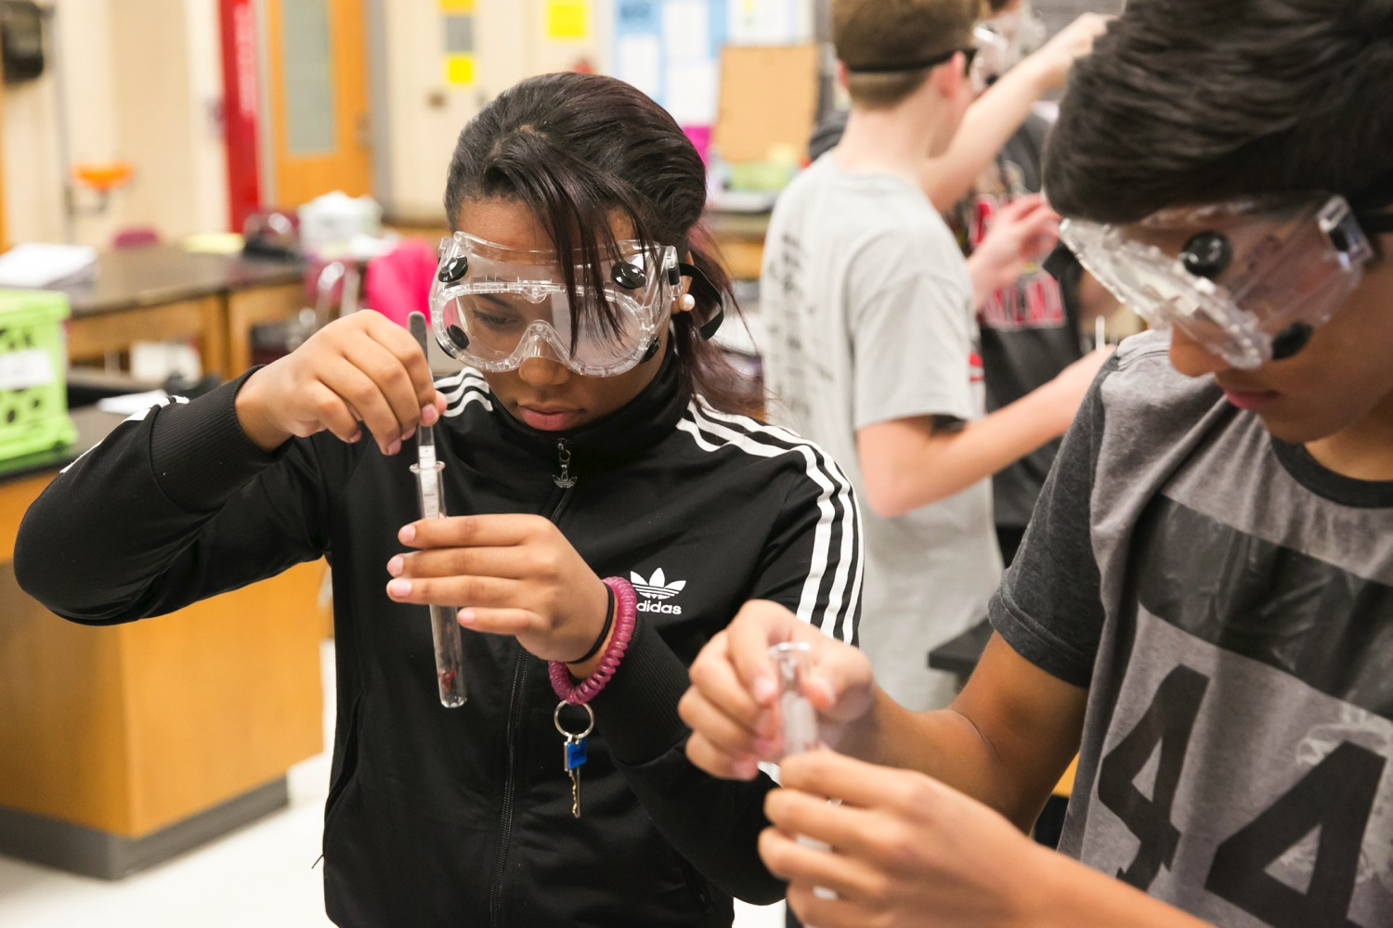
What Your Child Will Learn Guides
Algebra I
Biology
English 9-11
American Government
www.hcpss.org/academics
Notes:
What Your Child Will Learn guides for high school provide an overview of the instructional program for in Algebra I, American Government, English, and Biology. The guides include information that helps parents monitor and support their child’s progress during the school year.
Find the high school guides online at: www.hcpss.org/academics.
The guides are available online only; print versions are no longer distributed. Specific guide webpages may be printed from the website.
The guides provide general information about content covered in each curriculum area. Specific student programs may differ, depending on instructional needs.

Slide 52
Rotation of classes will start in 5 minutes. SAT Prep (period 5) will be meeting in the Media Center.

Slide 53
Teachers not available this evening
Jarrett Emery (PE/Health)
Lori Estes (English)
Frances Galante (Social Studies)
Michelle VanGieson (Media)
Jeremy Whitaker (Social Studies)

