Slide 1
High School
101
Class of 2022

Slide 2
Principal
Claire Hafets

Slide 3
Agenda
Welcome and Introductions
Graduation Requirements
Course Selection & Parent Responsibilities
Academy Programs
Fine Arts Program
A typical schedule of a 9th grader
Academic eligibility
Important Dates
Q & A
Elective Fair

Slide 4
Student Services ITL & 9th grade Counselor
Mrs. McKechnie & Mrs. Khaksari

Slide 5
What are the graduation requirements for the class of 2022?
Question 1

Slide 6

Credit Requirements
Service Learning
High School Assessments
Career Preparation

Slide 7
Credit Requirements
English | 4 credits |  | Health - 9 | 1/2 credit
Social Studies | 3 credits |  | Fine Arts | 1 credit
Mathematics* | 3 credits *must be enrolled in math all 4 years |  | Technology Ed. | 1 credit
Science | 3 credits |  | Program Choice | 2 - 4 credits
Lifetime Fitness | 1/2 credit |  | Electives | 1 - 3 credits
Notes:
* HCPSS now requires all students to be enrolled in math all 4 years. Mention the 4 credit math requirement for University of Maryland system.

Slide 8
Assessment Requirements
Students entering High School as a 9th grader in the fall of 2018 must pass the following assessments:
  Algebra I PARCC
  English 10 PARCC
  Maryland Integrated Science Assessment (MISA)
  Government HSA
  * Your student may have already passed the Algebra I PARCC if they took the course in middle school
Notes:
PARCC: Alg. I, Alg. II & Geo (maybe) HSA: Biology, Gov’t

Slide 9
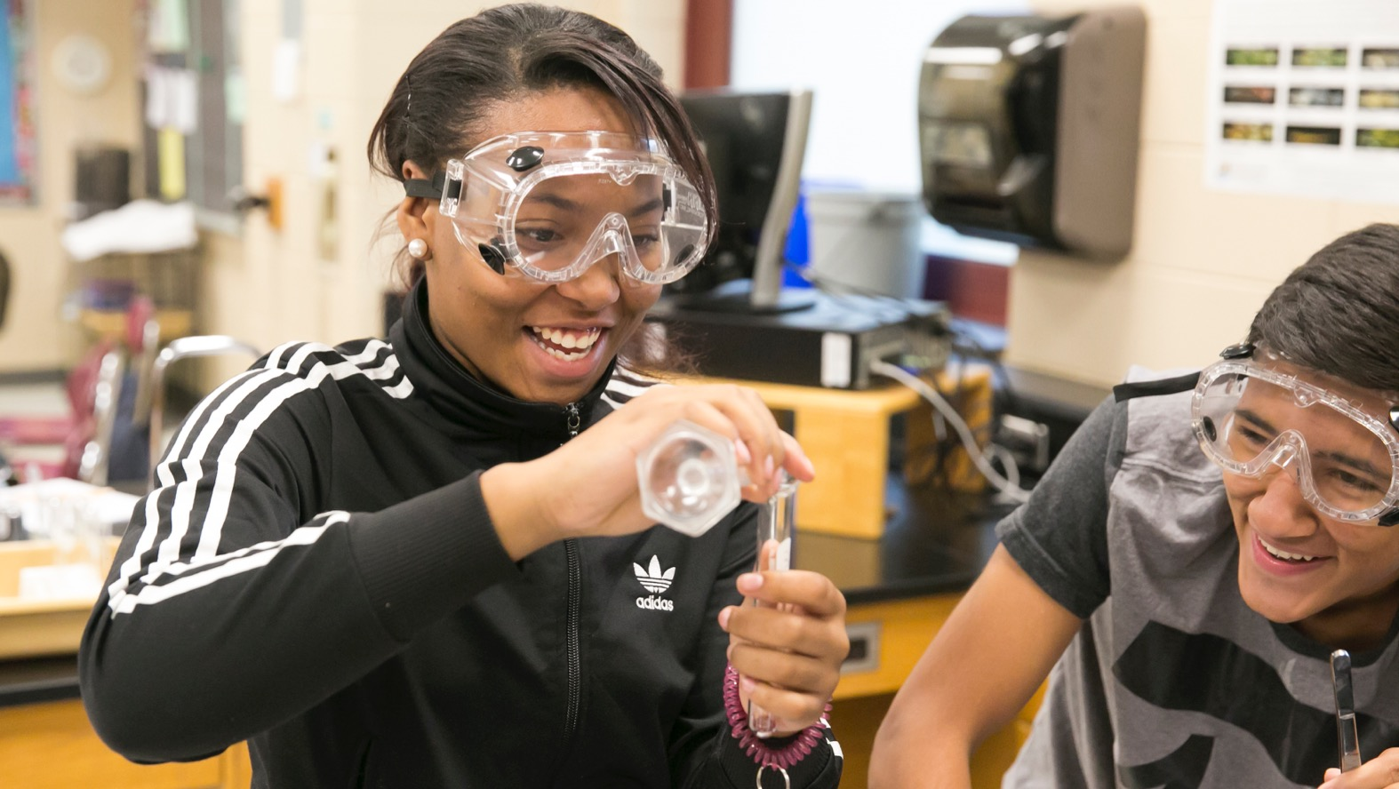
High School Science Transition
Curriculum and Assessments

Slide 10
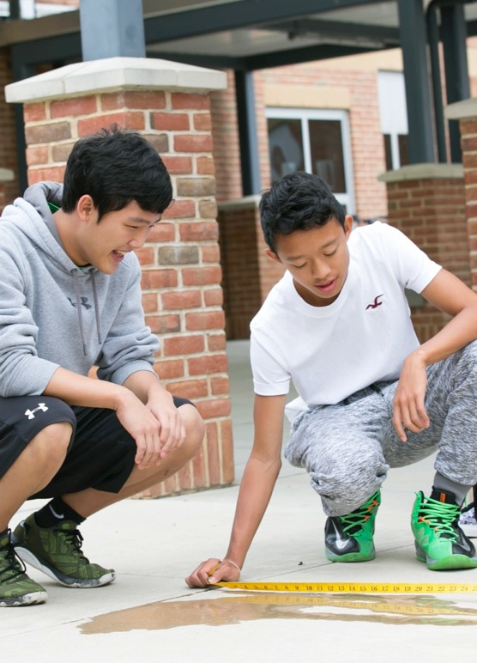
Maryland Integrated Science Assessment (MISA)
MSS aligned
Replaces Biology HSA
Online assessment
Taken after completing coursework in all 3 disciplines
  Earth/Space science
  Life science
  Physical science

Slide 11
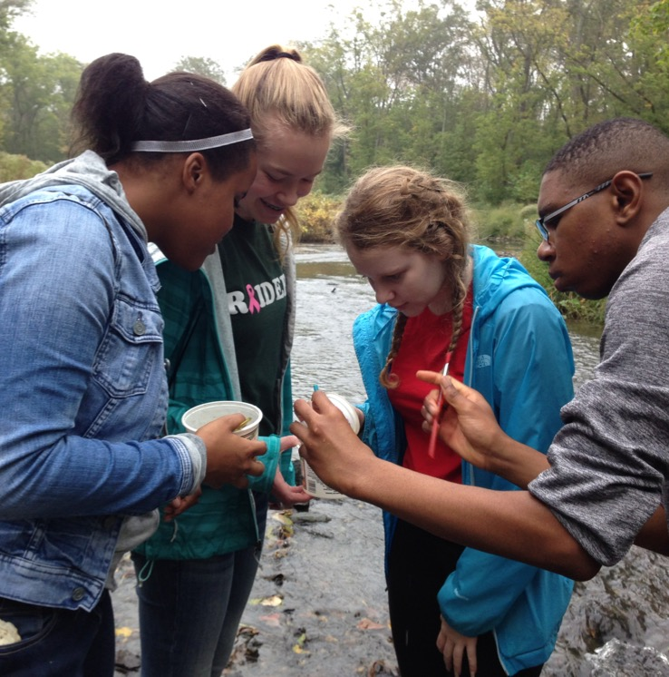
HS Science Curriculum
All students take courses that support all 3 science disciplines
  Earth/space science
  Life science
  Physical science
MISA after core courses completed
G/T and AP options in each discipline

Slide 12
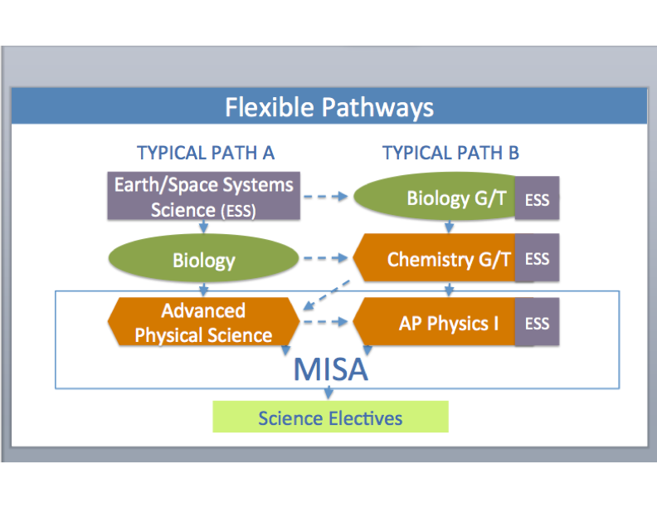
NEW: Science Curriculum

Slide 13
How does my child select classes?
Question 2

Slide 14
The Course Selection Process
Middle School Teacher makes course recommendation
Student takes course request form home
Parent reviews, signs and returns course request form to Middle School Counselor
Middle School Counselor reviews request form and forwards form to High School

Slide 16
What is my role in the course selection process?
Question 3

Slide 17
Talk with your child about goals for the next four years.
Review course recommendations with your child and make the best decision for your child.
Take the most rigorous courses possible while maintaining balance, so that your student may enjoy other aspects of high school.

Slide 18
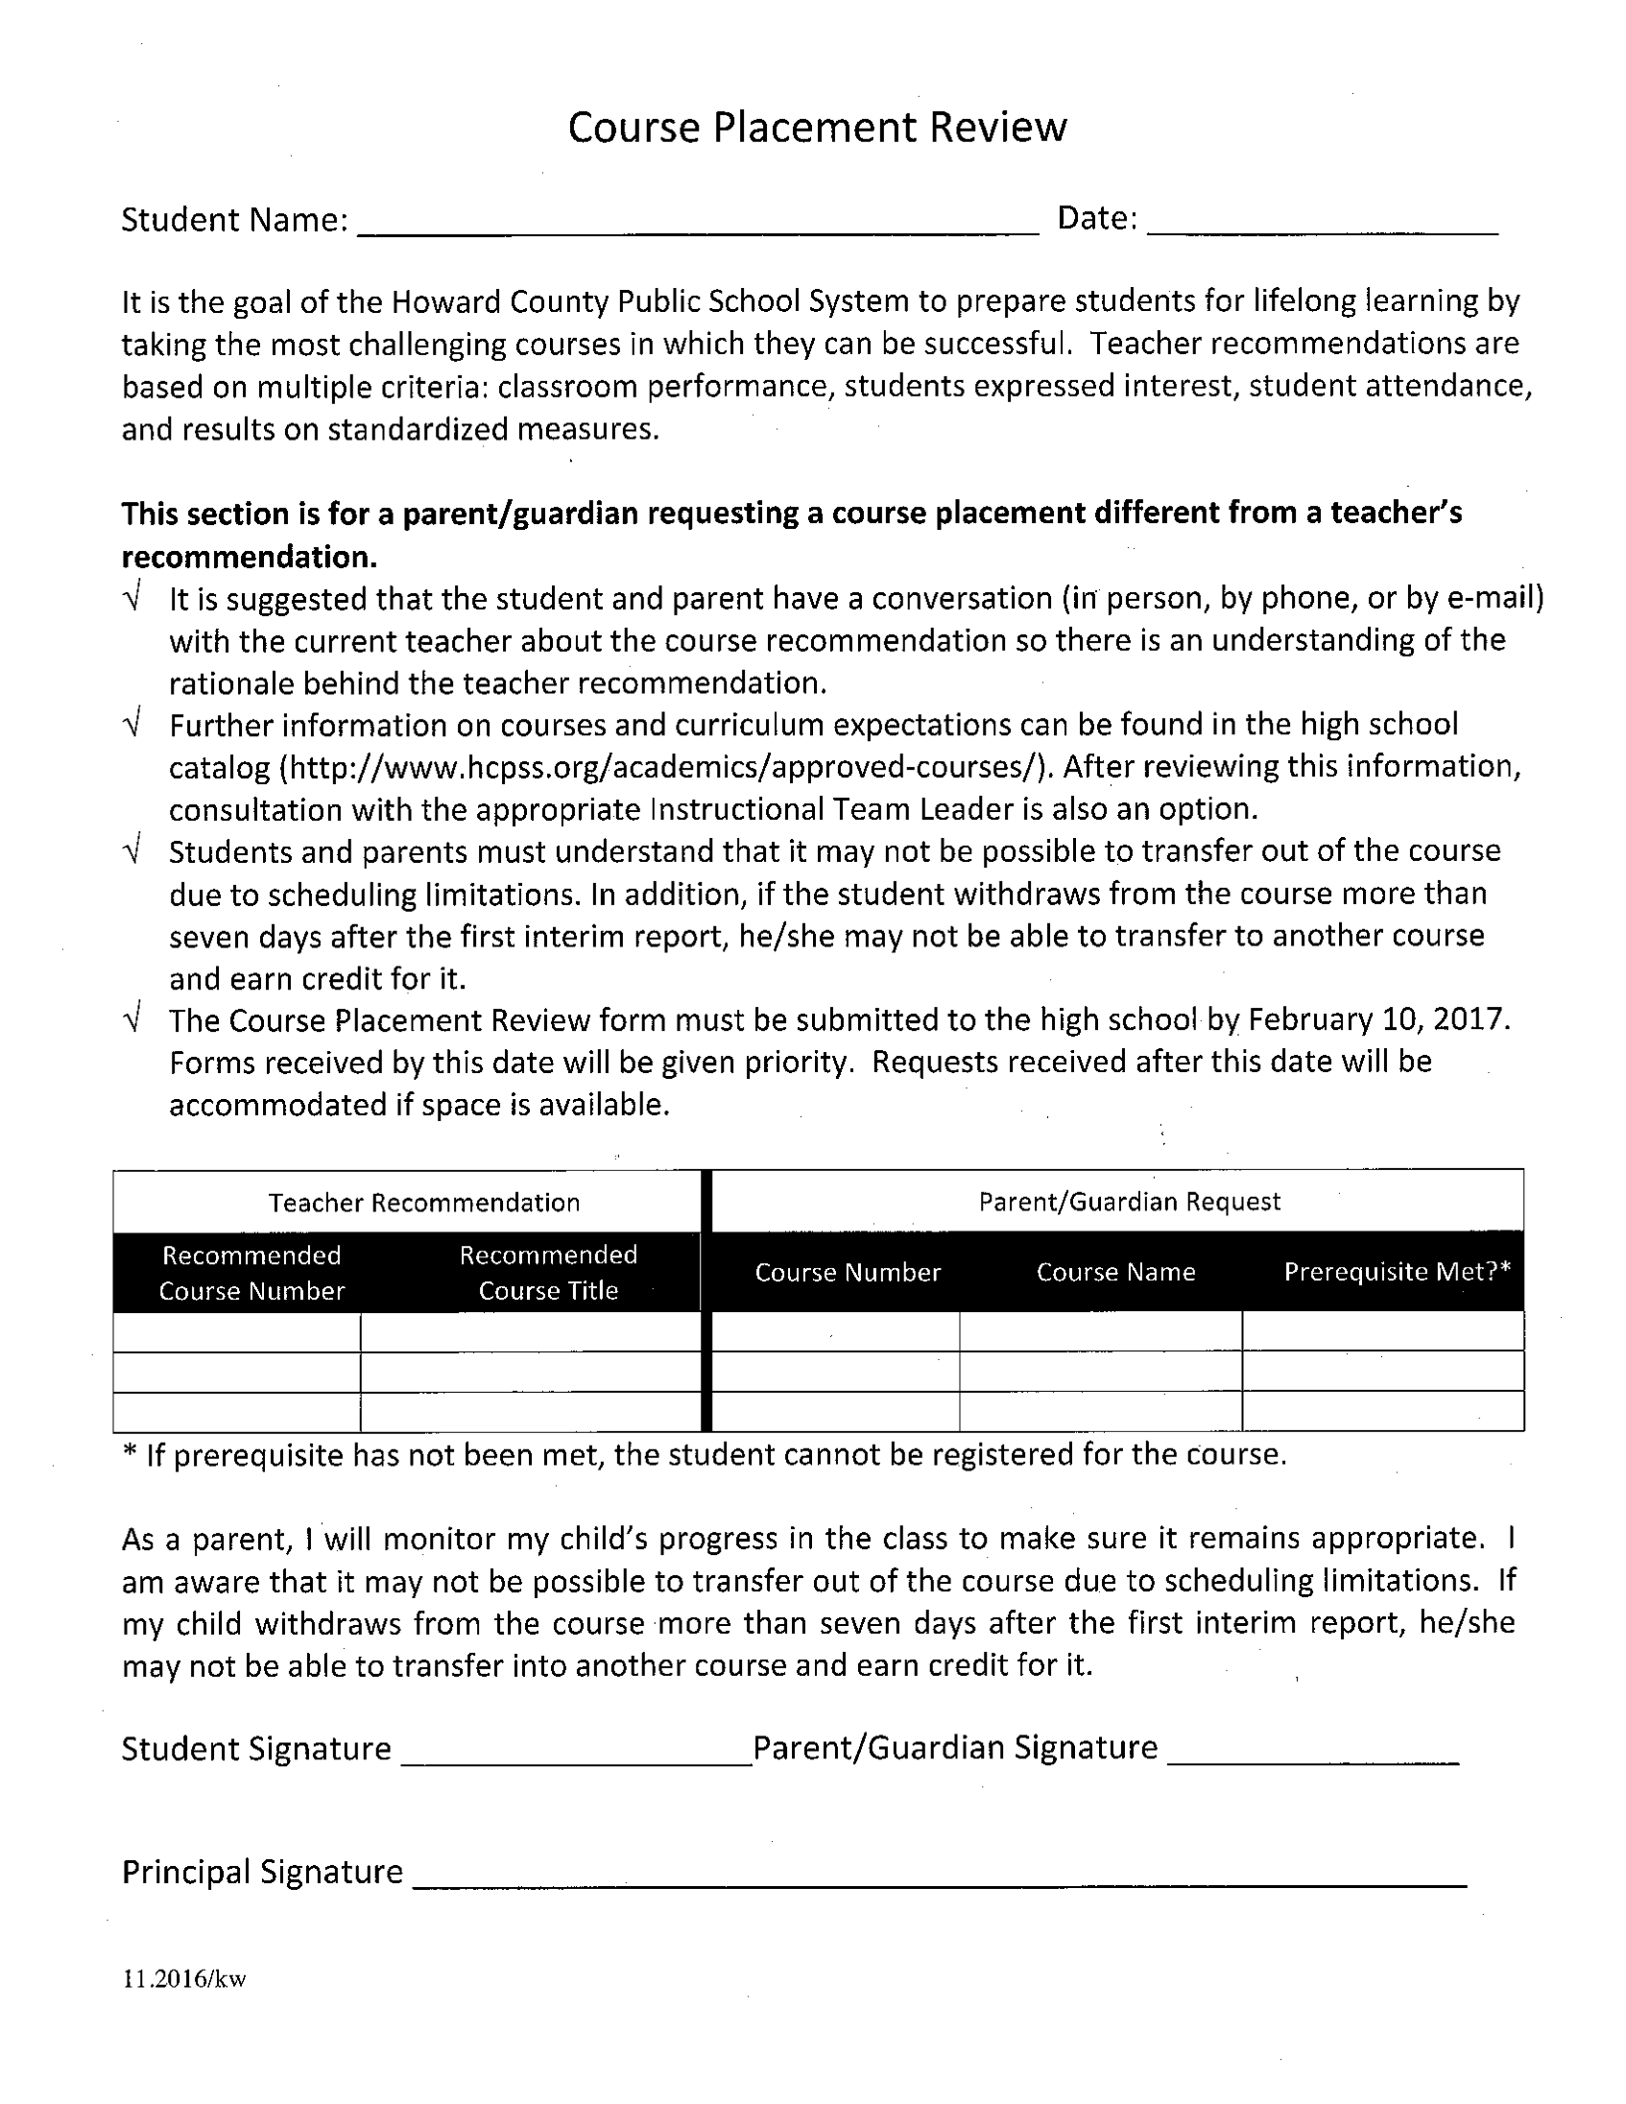

Slide 19
What is a typical academic schedule for a ninth grade student?
Question 4

Slide 20
A Typical 9th Grade Schedule
English 9/Hum-I Eng
United States History/Hum-I SS
Mathematics
Science
Health-9/ Lifetime Fitness
World Language (Program Choice)
Fine Arts or Technology
Notes:
Don’t forget to mention that The humanities sequence is different. Social Studies is Mod world in 9th grade and US in 11th grade. The Humanities courses fulfill the English and Social Studies credits.

Slide 21
Program Choices
Career & Technology Completer
World
Language
or
2 credits *
4 credits
Notes:
College park wants 4

Slide 22

JumpStart provides many benefits for students:
Explore career interests at a deeper level
Experience college-level courses prior to entering a college campus full time
Increase the likelihood of earning a college degree
Receive college credit at a significantly discounted rate
Notes:
Jenn - For LRHS, OMHS, CHS, RHHS or HoHS ONLY. For split schools, mention that there are expanding opportunities at our high schools to take college courses while in high school to start exploring career interests early.
The bullets in this slide are sequenced strategically. The first bullet emphasizes that the program is really about connecting students to their interests in a focused way; the second bullet emphasizes the benefit of easing the transition from high school to college; the third bullet refers to research on dual enrollment; and the fourth bullet we will talk about more in later slides…. but we can mention that HCC is offering credits at 50% of regular tuition.

Slide 23
Are you interested in:
Public Health Cyber Security
STEM Entrepreneurship
Health Sciences Criminal Justice
Teacher Education Computer Science
OR
Getting a jump on your college credits before you graduate from high school?
Consider JumpStart with pilot programs at Oakland Mills and River Hill high schools
Notes:
LRHS, CHS AND HOHS ONLY

Slide 24
Program offerings:
Oakland Mills
River Hill
Cyber Security
Public Health
STEM
Teacher Education
Computer Science
…or Getting a jump on your college credits before graduating high school?
Cyber Security
Entrepreneurship
Criminal Justice
Computer Science
…or Getting a jump on your college credits before graduating high school?
For more information go to hcpss.org/jumpstart

Slide 25
What are the Career Academy options?
Question 5

Slide 26
Career Academies at Centennial
Accounting Academy
Career, Research and Development
Computer Programming Academy
Culinary Science Academy
Marketing Academy
Pre-Engineering Academy (PLTW)
Teacher Academy
*Several other Academies offered at ARL

Slide 27
Mrs. Rebecca Clark
INSTRUCTIONAL TEAM LEADER OF PE & FINE ARTS

Slide 28
Question 6
What are the Fine Arts offerings at CHS?

Slide 29
Fine Arts Classes for Freshman
  Art I
  Theatre I
    Opportunity for placement in Theatre II or Musical Theatre is possible through audition.
  Dance I
    Opportunity for placement in a higher level is possible through audition.
  Music
  Band (audition required)
    Concert Choir (no audition for level one)
    Orchestra (audition required)

Slide 30
Fine Arts Audition Dates
Band – Auditions January 22nd – 26th David_Matchim@hcpss.org
Orchestra - Auditions January 24th – Feb 9th (in your middle school) Allen_Leung@hcpss.org
-------------------------------------------------------------------
Sign up for level one for the following courses, but if you have participated in instruction outside of school and would like to be considered for a higher level you must audition or submit a portfolio as follows:
Dance – Auditions February 15th 3:00 pm Rebecca_Clark@hcpss.org
Art - Submit Portfolio & Sketchbook by February 15th to Nan_Collins@hcpss.org 3:00- 4:30
Concert Choir - Contact Rebecca_Vanover@hcpss.org
Theatre - Submit audition video by January 31st to Kathryn_Carlsen@hcpss.org

Slide 31
Assistant
Principal
Mrs. Suber

Slide 32
What does the high school schedule look like?
Question 7

Slide 33
Normal Bell Schedule
 | Start | End | Class Time
Period 1 | 7:25 | 8:15 | 50 minutes
Period 2 | 8:20 | 9:10 | 50 minutes
Period 3 | 9:15 | 10:05 | 50 minutes
Period 4A and 4B | 10:10 | 12:25 | Includes a 30 minute lunch
Period 5 | 12:25 | 1:15 | 50 minutes
Period 6 | 1:20 | 2:10 | 50 minutes

Slide 34
Eagle Time Bell Schedule
 | Start | End | Class Time
Period 1 | 7:25 | 8:10 | 45 minutes
Period 2 | 8:15 | 9:00 | 45 minutes
Eagle Time | 9:05 | 9:30 | 25 minutes
Period 3 | 9:35 | 10:24 | 49 minutes
Period 4A and 4B | 10:29 | 12:30 | 121 min (Includes a 30 minute lunch)
Period 5 | 12:34 | 1:19 | 45 minutes
Period 6 | 1:24 | 2:10 | 46 minutes

Slide 35
Assistant
Principal
Mr. Rahnama
Mr. Rahnama

Slide 36
What is the attendance policy for high school students?
Question 8

Slide 37

All students are expected to attend regularly in accordance with public school laws.
Any student with unlawful absences of more than 5% of the course may be considered for denial of credit.

Slide 38
What is academic eligibility?
Question 9

Slide 39
Governs participation in all voluntary extracurricular activities.
Must maintain a 2.0 grade point average and no more than one failing grade for the marking period prior to the start of the activity.
All incoming 9th graders are academically eligible for fall extracurricular activities.
See Policy 9070.

Slide 40
What are some other important aspects of high school?
Question 10

Slide 41
Cheerleading/
Dance/
Poms
School
Clubs
School Plays/
Musicals
Extracurricular
Activities
Class Boards
Athletic Teams
Service
Clubs

Slide 42
Questions?
Break-Out Sessions
Visual Arts 301
Performing Arts 803 (Dance Studio)
Humanities Remain in Auditorium All Others in Cafeteria!

Slide 43

Please Visit:
www.chs.hcpss.org
Follow us on twitter
@hcpss_chs

