Slide 1
Agenda
Welcome & Introductions
What is a Midterm?
How to Study for Midterms
Course registration for next year

Slide 2
Student & Parent
Midterm Mastery Night
Centennial HS
MIDTERM REVIEW &
COURSE SCHEDULING

Slide 3
What is a midterm?
A test that covers
material from the
beginning of the
year to the present.

Slide 4
How will my midterm impact my overall grade?
Year-Long Course = 10% of the final grade
Semester Course (Health, Lifetime Fitness) = 20% of the final grade
Midterms DO NOT count towards eligibility for extra curricular activities

Slide 5
Schedule of Midterms
Tuesday, January 23 Full Day Exam 1
Wednesday, January 24 Half Day Exam 2 & 3
Thursday, January 25 Half Day Exam 4A & 4B
Friday, January 26 Half Day Exam 5 & 6
Wednesday—Friday:
Eagle Time between exams
Schools close 3 hours early
No extra curricular activities, except 1-½ hour conditioning practices which may begin at 2:45 p.m.

Slide 6
Midterm Review/Support
Extra Review with Teachers & Study Hall
Tuesday – Thursday, Jan. 16th – 18th
2:15pm – 3:45pm
**Reserve seats for the Activity Bus in advance by picking up a bus pass from the front office.

Slide 7
Studying for Midterms Some General Tips

Slide 8
Are there strategies to help me prepare for my midterms?
Eat Breakfast
Ask Questions
Get Organized
Lots of Review
Exercise
Study in Groups

Slide 9
Where are teachers’ review sheets?
ALL 9th grade teachers’ review sheets are available in one place online.
Go to the school website: http://chs.hcpss.org
Click on the tab “Academics”
Choose “Academic Resources”
Scroll down to “Midterm Review Packets” and click to open.
Students must use their HCPSS usernames to access the files.
Parents cannot access these files directly. Students must sign in to their school active directory.

Slide 10
Recommended Strategies
1) Using your teacher’s review sheet as a guide, organize your notes first. This process is part of reviewing because it will refresh your memory as to what you covered in class.
2) As you organize, pay attention to what you remember well versus what you don’t understand.

Slide 11
Recommended Strategies
3) Annotate your review sheet to highlight what you don’t understand. This will help you focus on the areas that you need to study first.
4) Now is the time to check with your teacher or another reliable student in the class if you don’t understand something. Don’t wait until the night before! This can cause unnecessary panic.

Slide 12
Recommended Strategies
5) Study from old quizzes and tests.
6) Redo key homework assignments.
7) Teach someone else what you know! Teaching is one of the best ways to evaluate how much you know.

Slide 13
Recommended Strategies
Use multiple intelligences
Study aloud.
Study with a partner.
Write things down on note cards.
Draw pictures to help you remember.

Slide 14
Recommended Strategies
Cramming (studying a few hours before the test or the night before) does not work. It has been proven to be very ineffective.
Study only 20 minutes at one sitting.
Take frequent breaks.
Study often – start tonight!

Slide 15
Fine Arts

Slide 16
Study Materials for Fine Arts
*Most mid-term exams are performance-based.
-Students have been preparing for exams in class.

Slide 17
Lifetime Fitness and Health

Slide 18
Study Materials for Lifetime Fitness
*Final Exam Study Guide
-Located on Canvas
* Review all chapter worksheets
* Book is available online, through Canvas

Slide 19
Study Materials for Health
*Final Exam Study Guide
Located on Canvas
Distributed to students this week
*Review Classroom Assignments
Vocabulary terms, Notes, Class Activities,
Tests, quizzes, and projects.
Notebooks were kept in the room all semester and can be taken home at any time to study.

Slide 20
Formats
Health Education Final Assessment
* about 100 Selected Response
Lifetime Fitness Final Exam
* about 75 Selected Response

Slide 21
Mathematics Assessments
Laying the groundwork for success in your mathematics classes.

Slide 22
What makes math different?
Specific tools or aides are often needed for successful completion of tasks.
Graphing calculator (TI-83 or TI-84)
Compass & straightedge (Geometry)
Practice is essential for skill mastery!

Slide 23
Who is assessed?
All math courses!
These courses have a higher concentration of freshman students
Algebra I
Geometry GT
Algebra II GT

Slide 24
After School Review Sessions
Students should check with their teacher
to find out
date
and
place
of review sessions.

Slide 25
Math Midterms
Exams consists of:
Multiple Choice
Short Answers
Word Problems
STUDY TIPS:
Go over review sheets, class notes, quizzes and past exams.

Slide 26
Possible Resources?
Review packets will be obtained from your teacher.
Review your course syllabus.
Review previous quizzes, chapter/unit tests.
Download the course’s essential curriculumwww.hcpss.org/math/essential.curriculum/essential.curriculum.html
Daily National Math Honor Society Tutoring

Slide 27
Math Department Requests…
Parents, take an active role in your child’s learning.
Materials, Materials, Materials!
All students should have their own graphing calculator.
Geometry students should own their own compass and straightedge.
Practice, Practice, Practice!
Ask for help!!!

Slide 28
UNITED STATES HISTORY
MIDTERM

Slide 29
Dr. Warren, Ms. Landi,
Ms. Borowski, Mr. Ahearn
Ms. Reese, & Mr. Tieperman

Slide 30
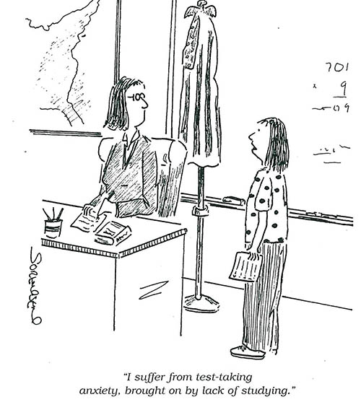
STUDY = SUCCESS
“I suffer from test taking anxiety brought on by a lack of studying.”
Notes:
START EARLY

Slide 32
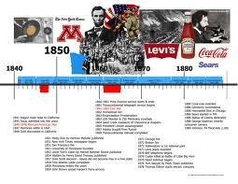
STUDY GUIDES
Each U.S. History teacher will give and/or post a review sheet to students.

Slide 33
HOW TO STUDY
Review class notes, worksheets, chapter/online readings, review sheets from previous tests
Participate in in-class reviews
Form a study group to quiz each other
Make or use teacher-prepared quizlet or kahoot

Slide 34
ADDITIONAL HELP
Attend the afterschool midterm review session
Bring completed midterm review sheets to session.
Identify topics for which student has questions. Ask questions at review.
Teachers will answer questions regarding accuracy and offer clarification on any confusing topics.

Slide 35
MID TERM FORMAT
multiple choice questions
Essay/short answer questions, especially for GT classes
Notes:
Sample questions coming…

Slide 36
The Homestead Act was important in the growth of the West because it…
A. set aside reservations for Native American Indians.
B. created the Department of Agriculture to aid farmers.
C. encouraged settlement of the Great Plains.
D. provided land to build a canal system.

Slide 37
During the 19th century, what was the major reason that an increasing number of states established public schools and passed compulsory education laws?
A. Reformers argued that an educated, literate population was necessary for a successful democracy.
B. The Supreme Court required the states to do so.
C. Most jobs required a high school diploma.
D. The United States had begun a massive program of technical training to enhance its international economic position.

Slide 38
English Department
Ms. Jacobsen, Ms. Mancini,
Mr. Sharbaugh, & Mr. Wheeler

Slide 39
English Midterm Exam
Outlines and review sheets for the exam will be distributed in class and are available on CHS’s webpage.
Material will be reviewed in class.

Slide 40
Types of Questions
Types of questions on the Midterm Exam for 9th grade students:
Selected Responses (multiple choice)—based on reading passages, vocabulary, grammar, and writing skills
Constructed Response—an additional essay or short answer in response to literature and/or topics learned in class

Slide 41
What should students study?
Literary terminology (direct and indirect characterization, theme, point of view, etc.)
Literary Devices (simile, metaphor, personification, etc.)
Vocabulary (from Sadlier-Oxford books or other lists that have been provided)
Grammar and writing skills
Research Process (if already completed in class)

Slide 42
How Do I Study?
Literature
Do NOT re-read novels; skim chapter notes, reviewing characters, setting, central conflict, etc.
Review study guides, activities, worksheets, and questions related to the reading. Be sure to think beyond the literal story and consider author’s message, and how he/she communicates that message.

Slide 43
How Do I Study?
Vocabulary
Check individual teacher review sheets for specifics on which words you need to know
Make flashcards or use Quizlet
Divide into chunks; review 5-10 words at a time

Slide 44
How Do I Study?
Grammar & Writing Skills
Review worksheets, class notes, and
activities.
For more practice, visit
www.owl.purdue.edu

Slide 45
Midterm exams
for
World Languages

Slide 46
What will the exams cover?
In short, everything studied this year: material covered in Semester 1 (Marking Periods 1 and 2).
Listening, Reading, Writing
Vocabulary, Grammar, Culture

Slide 47
How should I review?
Ask questions during in-class formal review!
Make flashcards or use Quizlet to review vocabulary / thematic concepts.
Utilize all your old quizzes and notes.
Organize, retake, correct them.
Attend after-school study sessions!
Practice online textbook activities! (in CANVAS).
If you are missing vocabulary or grammar information,
it can usually be found online.
Complete the review sheet!
(Posted on Canvas and on CHS website)

Slide 48
What is it going to look like?
Expect to be formally assessed on the exam in listening, reading and writing.
Primarily objective format-SCANTRON forms
&/or
Speaking / Writing section
(short answer / brief constructed response)

Slide 49
What will the CHINESE midterm exam look like?
Review sheet is posted online and on Canvas.
Oral and written portion will be completed in class.
The writing portion of the exam will be Multiple Choice, Fill-in-the Blank, and Short essay.

Slide 50
What will the FRENCH midterm exam look like?
It will consist of Multiple Choice items,
Short Answer and a Writing portion for
honors students.
All topics can be found on the CHS
website and Mr. Doff and Mrs. Doff will
be available to answer questions.

Slide 51
What will the GERMAN midterm exam look like?
Exam format: selected
and constructed response
Chapters 1A, 1B, 2A
and 2B from Mosaik 1
will be covered on the
exam.

Slide 52
What will the SPANISH midterm exam look like?
Exam format – SCANTRON
Listening section
Reading section
Writing section (BCR or short answer)
*Speaking section-see teacher
Teacher-specific review sheets will be online.

Slide 53
Spanish Midterms
Spanish 1
Sra. Alascia
Spanish 2/2H
Srta. Littmann Sra. Gerhold
Sra. McCarthy Sra. Montanez-Comito
Sra. Grimes Sra. Alascia
Spanish 3/3H
Sra. Grimes Sra. Gerhold
Sra. McCarthy Sra. Montanez-Comito

Slide 54
Spanish 2/2H & 3/3H Midterms
Midterm examinations are created in-house and all instructors of the same level collaborate to create the exam.
Midterm examinations are created to challenge students for the maximum exam time AND to assure formal assessment of all topics covered during Semester 1.
Please contact your child’s Spanish teacher for any additional extra-help sessions.

Slide 55
Resources
Check your teacher’s website and/or…
http://french.about.com
http://studyspanish.com
http://www.flashcardexchange.com
http://www.conjuguemos.com
http://www.classzone.com/french.cfm
www.PHSchool.com
(this is a Spanish textbook site)

Slide 56
Science Mid-term Info
Earth & Space
Biology GT

Slide 57
Study Materials
Earth & Space Science
Midterm Review Packet
Previous Tests & Quizzes
Chapters 4 (surface processes), 5 (meteorology), and 6 (climate)
Drawings, Warm-ups, & Drills
Lab Activities
End of chapter review questions

Slide 58
Format
Earth and Space Science Midterm
Format will be 100 selected response questions (true/false, multiple choice, and matching)
Exam covers first and second quarter material.

Slide 59
Earth/Space Review
Students are encouraged to complete the available study packets.
After school help is available after school during "Midterm Mastery" week or by sending your questions via e-mail to lori_griffiths@hcpss.org or todd_rosenfeld@hcpss.org

Slide 60
Study Materials
Biology GT
* Midterm Study Guide
* Previous Tests & Quizzes
* Appropriate Chapters in the Textbook
* Drawings, Warm-ups, & Drills
* Lab Activities

Slide 61
GT Biology
Format
* 50 -100 multiple choice questions
* Exam covers first and second quarter material.
Review Sessions
* Bring suggested study materials to review sessions as
well as specific questions you have about the material!
Notes:
Application based selected response questions on material covered first semester.

Slide 62
Midterm exams
for
Foundations of Technology
PLTW ED G/T

Slide 63
FoT & PLTW - ED
Exams are composed of:
• Selected-response (select BEST)
• Multiple- response (select ALL appropriate)
• True/False
• Matching
• Short answer (terms, numeric response)

Slide 64
Study Materials for FoT/PLTW ED
*Midterm Exam Content
Located on Canvas as a Student
*Review Classroom Assignments
Vocabulary terms, Notes, Class Activities,
Tests, quizzes, and projects.
Notebook may be taken home to study.

Slide 65
FOT & PLTW - ED
Students may effectively prepare by:
• working with a study partner
• consulting Canvas on-line resources
• coming after school for extra help
• reviewing old assignments, projects, quizzes & tests

Slide 66
Any Questions?
Next: Course Selection and computing final grades

Slide 67
Midterm Grades
Computing Final Grades

Slide 68
Do my grades on midterm exams affect my eligibility for extracurricular activities?
No

Slide 69
Computing Final Grades
For a one credit class, write down each quarter, midterm and final grade.
Transpose each grade its numerical equivalent. (see below)
Multiply each quarter grade by two and each exam grade by one.
Add all the numbers together to get the total.
Divide the total by 10
Look on the chart to translate the number back to a letter grade.

Slide 70
EXAMPLE: Biology GT grades
1st qtr 2nd qtr Mid-Term 3rd qtr 4th qtr Final Exam
Letter Grade B B A B C B
Value 3 3 4 3 2 3
Multiply by x 2 x 2 x 1 x 2 x 2 x 1
_________________________________________________________
6 + 6 + 4 + 6 + 4 + 3
Total = 29 Divide Total 29 by 10 = 2.9
(Divide by 5 for a semester course.)
Letter Grade B = 3.0
The student needs a total of 8 quality points in order to get a passing grade. They cannot pass for the year if they fail a total of 3 quarters or fail 3rd and 4th quarter.

Slide 71
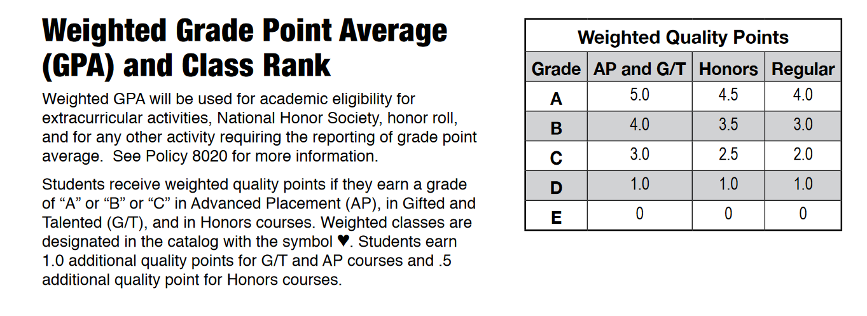

Slide 72
What is my role in the course selection process?
Next Year’s Schedule

Slide 73
This year students will make course requests on line in Synergy
Counselors will be handing out materials to 9th graders on January 11th during Eagle Time.
Students will watch an instruction video that will walk them through the registration process (video is available on-line)
Parents will have access to student information in Synergy
Students must enter 7 courses and 3 alternates (for elective courses) by January 19th
Student Services will be hosting two evening open houses on January 17th and 18th, from 5 to 7 pm, in the student services classroom area for those who do not have internet access.

Slide 74
Materials to look for
Color coded (yellow) sheet with teacher recommendations with Course Placement Review form on reverse
Quick reference list of high school course numbers
Please go to the HCPSS website or Naviance to view the Catalog of Approved High School Courses
If you do not have a computer or internet access, we will be hosting two evening open houses on January 17th and 18th, from 5 to 7 pm, in student services
If you have additional questions please talk to your child’s counselor.

Slide 76
Important dates
All course placement review forms are due by January 19th
Student window to enter course requests is open now and will close on January 19th
Counselors will begin to meet with students individually through English classes the week of February 5th.

Slide 77
Questions?

