Slide 1
Senior Parent Night
College Applications & Transcript Process
2017-2018
Centennial High School
Office of Student Services

Slide 2
Agenda
Introductions
Review Senior activities
College Planning
College Applications
Transcript Requests
Letters of recommendation
Scholarships

Slide 3
Student Services Staff
Counselors:
Jennifer McKechnie A-C, (ITL)
Todd Kriner D-H
Jae Hi Hebler I-Ma
Christian Sanders Mb-Si
Ellen Mauser Sj-Z
Irene Khaksari 9th grade
Secretary – Carole Sormanti
Registrar - Cathy Aballo
Registrar – Kimberly Tracy

Slide 4
So far this year…
Counselors have:
Held individual meetings with seniors
Provided seniors with a copy of transcript to review
Provided materials for college application and transcript request process
Reviewed Naviance process for letters of recommendations
Assisted seniors in linking the common application to Naviance

Slide 5
Still to come…
Senior class rank will be available for seniors to view in Naviance in the beginning of October (as per county policy)
College visits
Scholarship Information
Naviance lessons/surveys

Slide 6
College Planning
College entrance tests
  SAT
  SAT Subject Tests
  ACT
  AP
Type of admission
  Early Decision/Early Action/Priority/Regular/Rolling
Student Athletes
  NCAA www.eligibilitycenter.org
Should be filled out now for D-1 and D-2 schools

Slide 7
The Search
Review college list from last year
Attend College Visits
Naviance
Things to consider
  Geography
  Legacy
  Recruitment
  Special program of study

Slide 8
Applications
How many are enough?
1 or 2 Reach schools (your academics are below admission averages)
2 or 3 Ideal schools (fit your credentials)
1 or 2 Likely schools (you meet their criteria and would be happy to attend)
Consider your local community college

Slide 9

Applications and Essays
Students should currently be working on their applications
College Essay is first English 12 writing assignment.
PSAT Day- Wednesday, October 11 - English teachers will provide feedback on college essays
College Visit - don’t forget a prearranged absence form.

Slide 10
Applications
Apply to colleges online
Proofread application and print and save before sending
Look for e-mail confirmation within 24 hours.
Do not wait until last minute
Do not forget to request test scores from College Board or ACT
Watch deadlines

Slide 11
Transcript Request Procedures

Slide 12


Important people to know---
OUR
REGISTRARS!
Cathy Aballo
Kimberly Tracy

Slide 13
Transcript Request Process…
What is included in a Transcript:
  Courses and final grades from 9th-11th *8th grade
  Senior year schedule
  Quarter 1 report card, if requested after Nov 17
  Weighted and unweighted GPA and ranking
  CHS profile
  Description of special program, if applicable
ALL TRANSCRIPS WILL BE SENT ELECTRONICALLY
Any school (few and rare) that wants a paper copy we will send a paper copy.
Keep in mind, senior ranking will occur the week of October 2, 2017!

Slide 14
The Transcript Packet will NOT include:
HSA or PARCC scores
Standardized test scores (PSAT, SAT I /ACT SAT II& AP) are NOT included on the transcript. Please remember to request from College Board!!
College Board charges a fee to send test scores to the college(s) of your choice.
Remember to request 4 for free when taking the test!

Slide 15
Mid-Year & End of the Year Reports:
Colleges will see first and second quarter grades as well as mid-term exam grades!!
We will automatically send mid-year reports as soon as they become available
There is no additional charge for mid-year reports and end-of-year transcripts!!!
Your student will complete a survey at the end of the year in Naviance to let us know where to send a copy of the final transcript.

Slide 16
Transcript Request Process
Students must apply to the college on line or through the Common Application
Complete and sign a transcript request form
There is no charge for the first three transcripts, after the three, transcripts are $2.00 each
Required 4 weeks (20 school days) notice for transcript. Include an accurate deadline
Registrars will add colleges to the “colleges I’m applying to” page in Naviance
Your student should not invite a teacher to write a letter through Naviance until this has been completed.
Transcripts, and letters are submitted electronically through Naviance

Slide 17
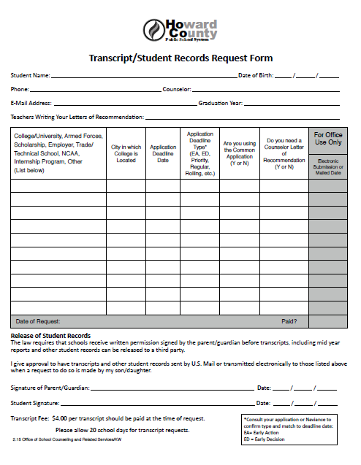
Transcript Request Form

Slide 18
Where to find a TRANSCRIPT REQUEST form
NAVIANCE
STUDENT SERVICES
  Home Page
  ⇩
  Document Library
  ⇩
  College Application Documents
  ⇩
  Find “Student Records Transcript Request” and click “View”
  ⇩
  Print Page
  ⇨ Complete and print
  ⇨ Return to Student Services
Pick up a Blue paper form in Student Services
⇨ Complete
⇨ Return to Student Services
We require 4 weeks/20 days notice to provide a transcript so please factor this in with the college deadline

Slide 19
Creating a Common App. Account
www.commonapp.org
Complete Education section
Add at least one college to your My Colleges tab in the College Search tab
Under the My Colleges tab, click on one college (on left hand side), the click on Recommenders and FERPA. Complete this section.
Go back to Naviance, Colleges Tab, “Colleges I am Applying to,” match you accounts by entering the email you used for your Common App.

Slide 20
CONNECTING NAVIANCE to your
COMMON APPLICATION ACCOUNT
IN ORDER TO SEND TRANSCRIPTS AND RECOMMENDATIONS ELECTRONICALLY, you must:
  Sign the FERPA Waiver on Common App
  Connect your Common APP account to Naviance
  THIS MUST BE DONE IF YOU ARE USING COMMON APP FOR ONE OR MORE APPLICATIONS.
If you are not using COMMON APP at all, you do not need to do this.
DEMO

Slide 21
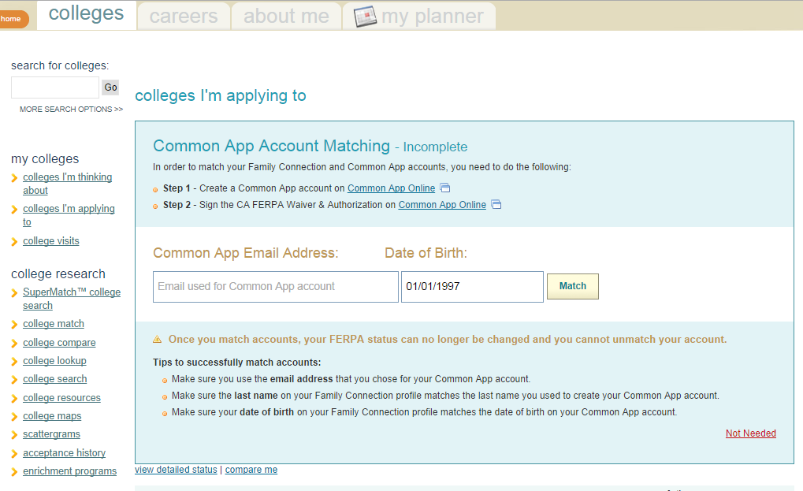
Common App Matching on Naviance

Slide 22
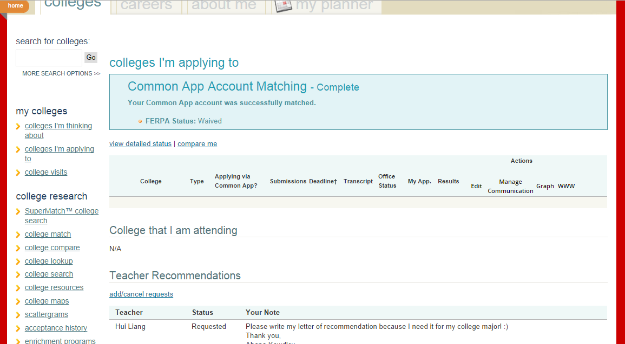
Matched on Naviance

Slide 23

Recommendation Process - Review
Talk to teachers and counselors
Sign and turn in release of information and waiver forms
Invite teachers through Naviance (turn in transcript request first)
Check your account for submission
Naviance is your on-line tracking system

Slide 24
Review of College Application Process
Select college(s) & Submit a Transcript request form
Students talk to Teachers about recommendation letters
Students invite Teachers to write letters through Naviance
ALL letters of recommendation and transcripts will be submitted electronically.
If you find a school that only accepts paper transcripts we will send a paper copy

Slide 25
Local College Fairs
Howard County College Fair
Sunday, October 15, 1-3 pm
Howard Community College
Washington DC National College Fair
Tuesday, November 5th, 12:30 – 4:00 pm
Walter E. Washington Convention Center
Baltimore National College Fair
Mon. Oct. 30, 9 am-noon & 6:00- 8:30 pm
Tues. Oct 31, 9 am – 11:30 am
Baltimore Convention Center
Washington D.C. Performing & Visual Arts Fair
Sunday, October 1st , 1:00-3:30
Walter E. Washington Convention Center

Slide 26
…Other Important Programs
Regional Financial Aid Nights
FAFSA NIGHT
Thursday, Sept. 27 7:00pm CHS Auditorium
Fine Arts College Night - TBA
Military Information Night
Check our website for dates, times and locations.

Slide 27
Financial Aid
FAFSA available to start October 1st
  County-wide seminars on Financial Aid
CSS/School Profile:
  Usually private colleges
  Done through College Board
    with a fee

Slide 28
Scholarships:
Scholarships Advertised via:
    chs.hcpss.org -Link to the HCPSS scholarship site
    fastweb.com
    “Scholarships” file in Student Services
    Advertised on our website & Naviance (CHS e-mail)

Slide 29

Encourage Your Student to Visit his/her Counselor
Student Services Hours:
7:10 AM -2:45 PM

Slide 30
Information
www.chs.hcpss.org
CEEB School Code: 210509
4300 Centennial Lane Ellicott City, MD 21042
jmckechnie@hcpss.org
todd_kriner@hcpss.org
jaehi_hebler@hcpss.org
christian_sanders@hcpss.org
ellen_mauser@hcpss.org
irene_khaksari@hcpss.org
CHS Phone # (410) 313-2856
    Student Services Office: (410) 313-2857
    Fax# (410) 313-2534

